Slide 1
ECE 202A - Embedded Systems
WebAssembly for Mbed
Utsav Munendra | Undergrad, CS
Arelys Navarro | Grad, EE
Howard Xie | Grad, CS

Slide 2
Agenda
Objective and Approach
Implementation
Results
Evaluation
Comparison
Project Analysis
Conclusion

Slide 3
Objective and Approach

Slide 4


Objective
Background
WebAssembly is an up-and-coming byte code format
Right now, mostly used in web browsers
Many interpreters and runtime available to run WASM in embedded platforms
WAMR, WASM3
WebAssembly is more secure than natively programming in C/C++
Objective
Port WebAssembly Micro Runtime (WAMR) to run on Mbed OS.
Notes:
Secure how? Stack bounds checks, checking that all pointer dereference belong to the function and are not from anywhere in the device’s memory
Include objectives and approach detail including brief references to other work

Slide 5


Technical Approach
Running WebAssembly Micro Runtime (WAMR) on Zephyr
Open-source code provided by Bytecode Alliance​
Configure CMake to build Mbed
Porting WAMR to Mbed OS​
Implement platform API layer​
Compile WAMR with Mbed OS libraries​
Evaluate WAMR on Mbed OS​

Slide 6
Implementation

Slide 7
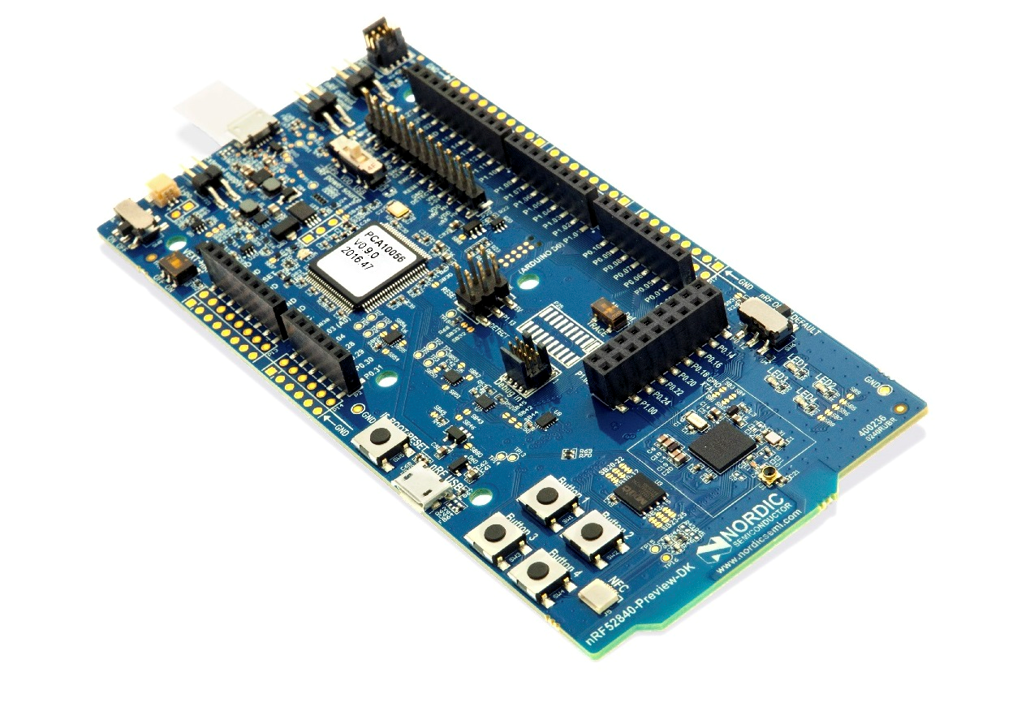
Implementation
Getting WAMR running on Zephyr
Compiling WASM Modules
Setting up our build system
New version of CMake had bugs
Running the mini-product provided for Zephyr
Finding correct syntax to export native function, passing values to WAMR functions and storing returned results
Setting up WASI-SDK
Configuring correct sysroot
Exporting functions which are linked to native functions by WAMR

Slide 8
Implementation
Porting WAMR to Mbed
Integrating Build Systems
Implemented the API layer​ which makes WAMR platform independent
CMake file to build WAMR for Mbed
Added the mini-product
Cmake files merged with WAMR
Two approaches attempted
WAMR is included into static

Slide 9
Implementation
Scripts
Make serial monitor available
Opens port while identifying COM port and pauses on command
Compiling WASM modules
Build WAMR and Mbed together
Notes:
Insert still photo of final implementation (Arduino to adapter to jtag and wires)
Note demo video link but also link will be submitted via the Google form

Slide 10
Results

Slide 11
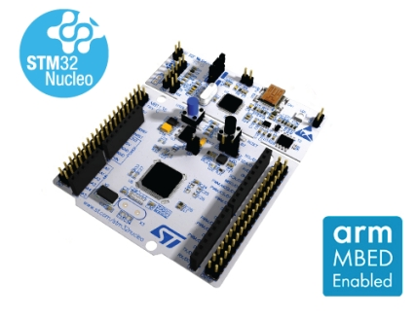
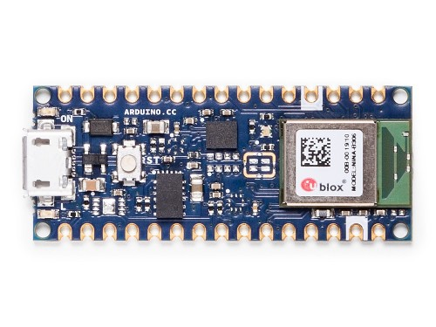
Results
WAMR Available on All Mbed Devices
Compiles and runs on Mbed-enabled STM32F411 Nucleo
Compiles for Arduino Nano 33 BLE
Notes:
Results of implementation. This slide should show, what did we accomplish?

Slide 12
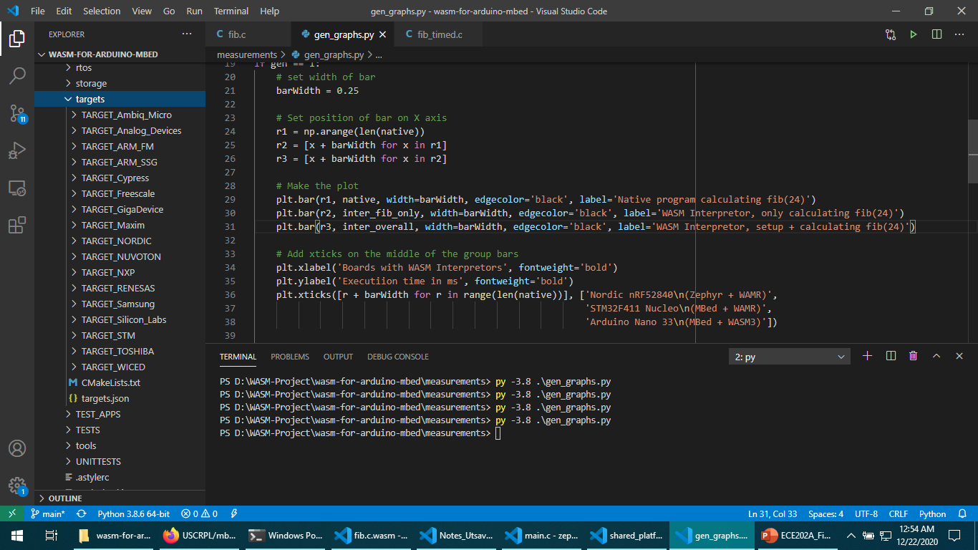
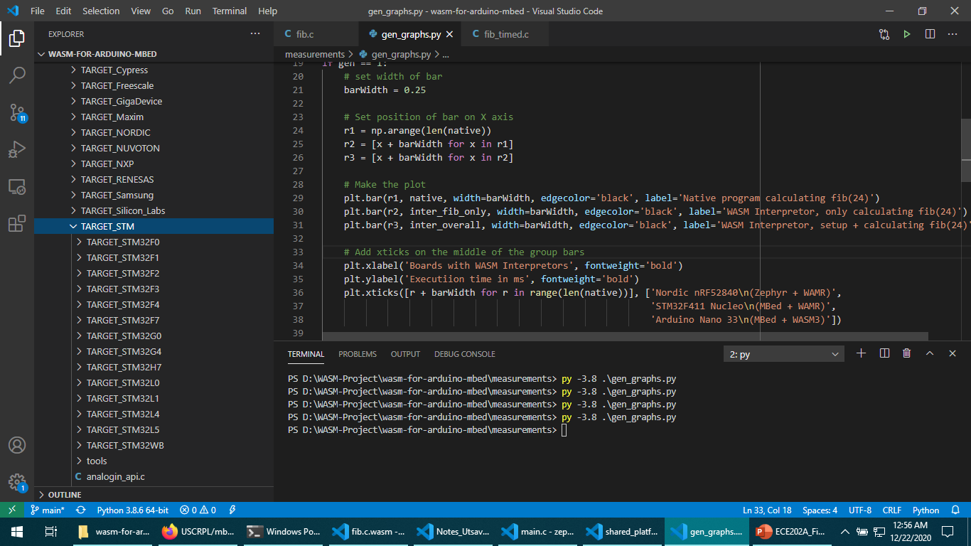
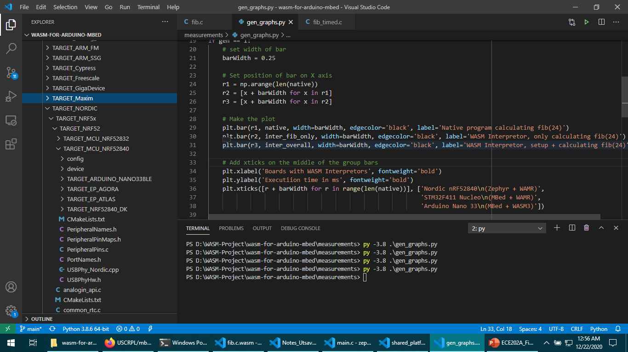
Results
WAMR Available on All Mbed Devices
Available for all targets supported by USCRPL Mbed-CMake
Tables of available targets for Mbed-Cmake
Notes:
Results of implementation. This slide should show, what did we accomplish?

Slide 13
Evaluation

Slide 14
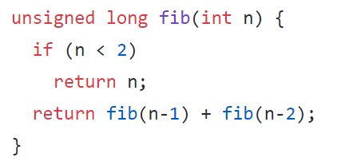
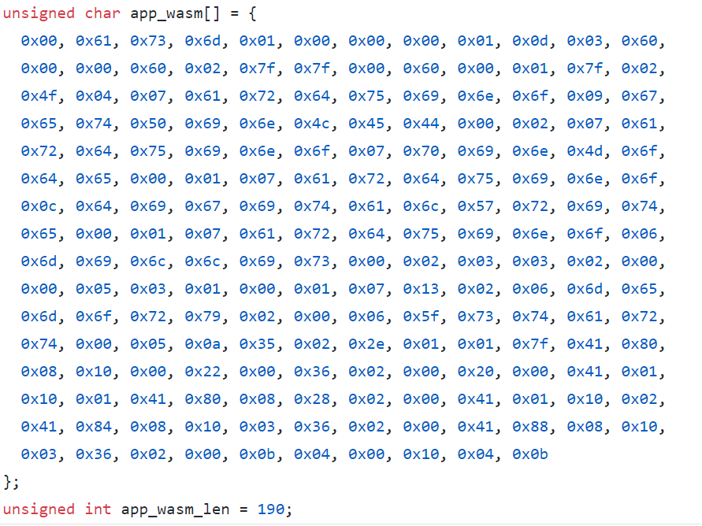
Comparison: WASM3
WASM3
WASM interpreter for embedded devices
Can be used on Arduino Nano 33 BLE
Arduino code created implementing calculation of 24th Fibonacci number
C++
Compiles to WASM
Timing results shown in next section
Portion of C++ code for Fibonacci execution
Compiled WASM bytecode
Notes:
Note demo video link but also link will be submitted via the Google form

Slide 15
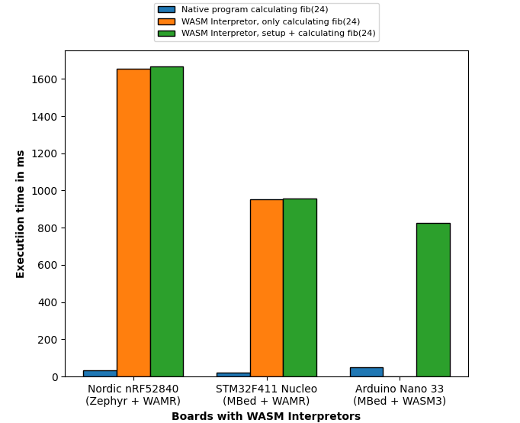
Evaluation
Embedded Board | Speed Penalty
Nordic nRF52840 (Zephyr OS, WAMR) | 47x
STM Nucleo (MBed OS, WAMR) | 43x
Arduino Nano 33 BLE (MBed OS, Wasm3) | 24x
Notes:
Table for comparing timing of WASM3/WAMR/Zephyr implementations

Slide 16
Project Analysis
Strengths
Weaknesses
WebAssembly is more secure than native C code
Ahead of time (AoT) and JIT available on WAMR (but not supported yet on Mbed)
Arduino implementation requires bootloader support
WASM3 implementation on Nucleo board
Ahead of time (AoT) implementation has been disabled for our project

Slide 17
Conclusion
WebAssembly can now be run on devices running MBed OS
WAMR ported to MBed
Notes:
In future iterations of this project we would expand on work by enabling and implementing WAMR’s AOT functionality.

Slide 19
References
A. Jangda, B. Powers, E. D. Berger and A. Guha, "Not so fast: Analyzing the performance of webassembly vs. native code", 2019 {USENIX} Annual Technical Conference ({USENIX}{ATC}19), pp. 107-120, 2019.
E. Wen and G. Weber, "Wasmachine: Bring IoT up to Speed with A WebAssembly OS," 2020 IEEE International Conference on Pervasive Computing and Communications Workshops (PerCom Workshops), Austin, TX, USA, 2020, pp. 1-4, doi: 10.1109/PerComWorkshops48775.2020.9156135. ​

